Slide 1


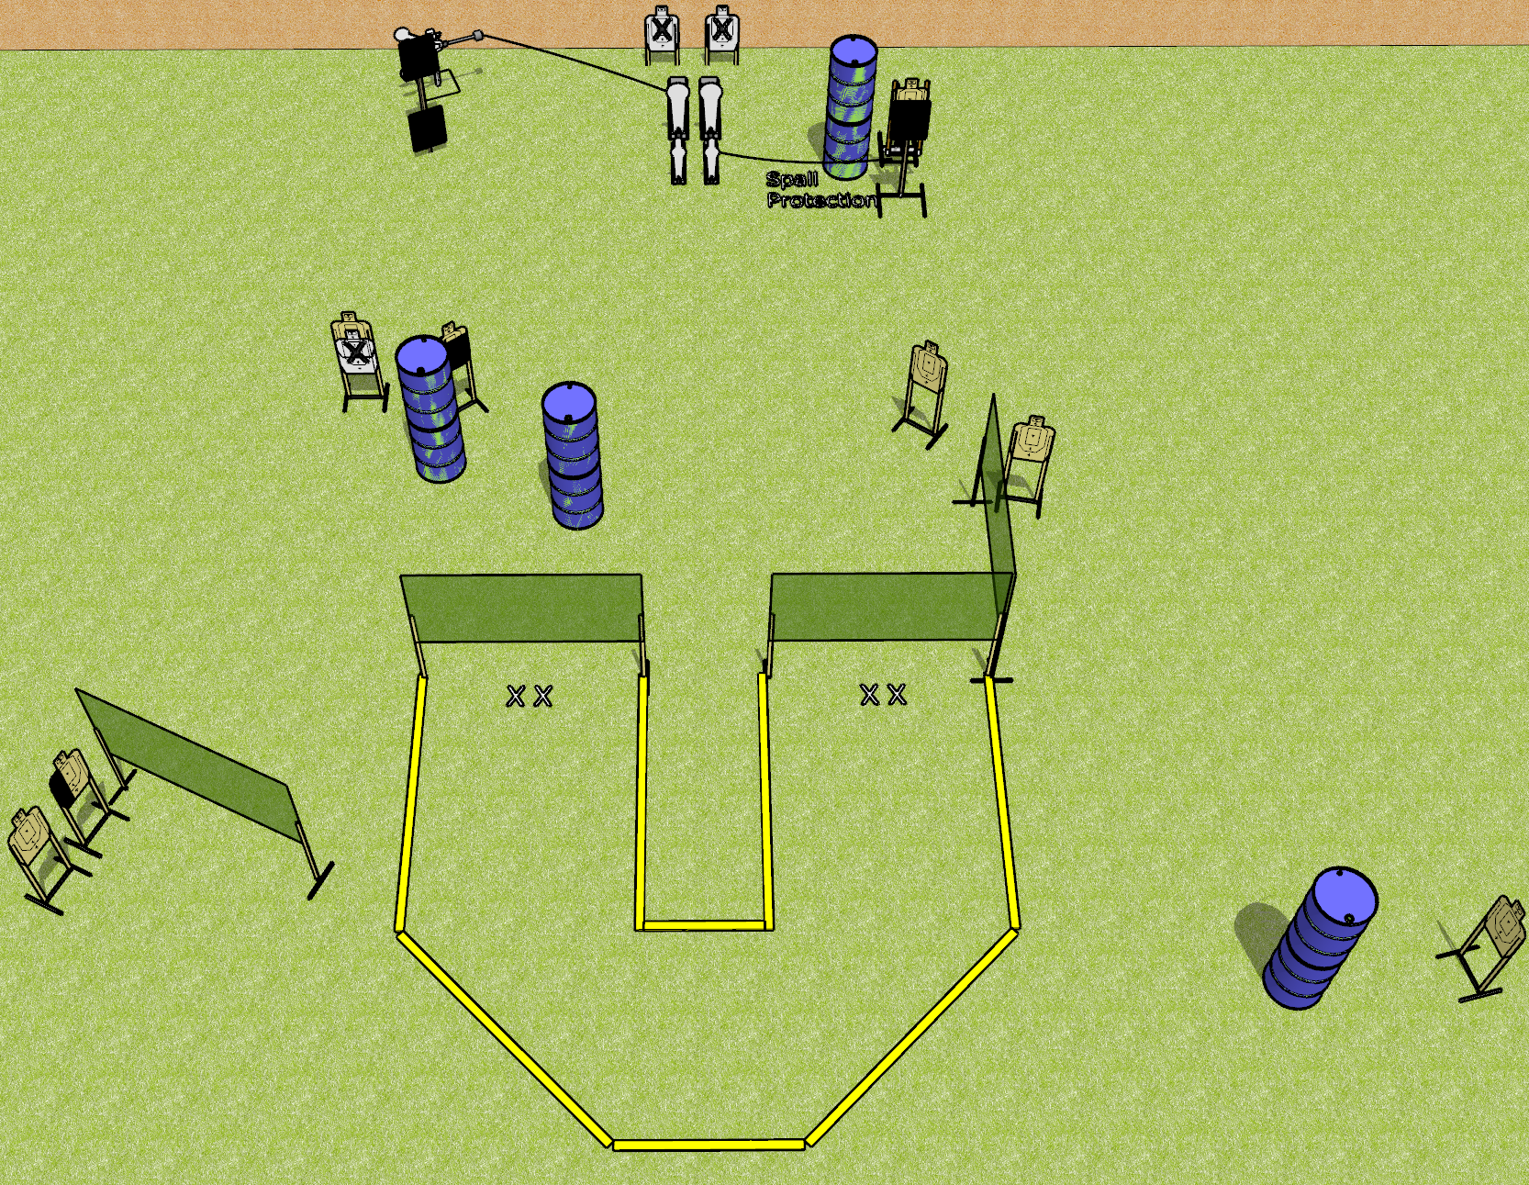
 | Dothan Gun Club – USPSA Match Footwork Course Designer : Drew Coleman
Round Count 22 rounds 9 USPSA targets 2 colt poppers, 2 mini poppers, 2 falling plates
Equipment List 7 wall feet 3 18x24 plates + stands 1 bobber Red stitch swinger 2 medium fault lines 1 50%, 1 left HC

Slide 2
Footwork
Written Stage Briefing
Footwork is a 22 round, 110 point, Comstock course of fire. There are 9 USPSA targets, 2 colt poppers, 2 mini poppers, and 2 falling plates. The best 2 hits on paper will score, and steel must fall to score. The start signal is audible.
The swinging steel target is activated by the left colt popper. The bobber is activated by the right mini popper. Please check the activators prior to walkthrough and set them the same way every time.
Handgun start position is both feet on either set of X’s, wrists below belt. Handgun is loaded and holstered.
PCC start position is both feet on either set of X’s. Loaded carbine is held with both hands, stock on belt, safety on.
On start signal, engage targets from within the shooting area.

